Slide 1
CYCLOMATIC COMPLEXITY
CALCULATION | EXAMPLES
Prepard By: Dr.V.Arulkumar, AP, IT

Slide 2
WHAT IS IT?
Developed by Thomas McCabe
Described (informally) as the number of decision points + 1
It is a software metric that measures the logical complexity of the program code.
It counts the number of decisions in the given program code.
It measures the number of linearly independent paths through the program code.

Slide 3
Cyclomatic complexity indicates several information about the program code-
Cyclomatic Complexity | Meaning
1 – 10 | Structured and Well Written Code High Testability Less Cost and Effort
10 – 20 | Complex Code Medium Testability Medium Cost and Effort
20 – 40 | Very Complex Code Low Testability High Cost and Effort
> 40 | Highly Complex Code Not at all Testable Very High Cost and Effort

Slide 4
IMPORTANCE OF CYCLOMATIC COMPLEXITY-
It helps in determining the software quality.
It is an important indicator of program code’s readability, maintainability and portability.
It helps the developers and testers to determine independent path executions.
It helps to focus more on the uncovered paths.
It evaluates the risk associated with the application or program.
It provides assurance to the developers that all the paths have been tested at least once.

Slide 5
Cyclomatic Complexity V(G)
Computing the cyclomatic
complexity:
number of simple decisions + 1
or
number of enclosed areas + 1
In this case, V(G) = 4
From Pressman Slides - Software Engineering a Practical Approach 6,e

Slide 6
Graph Complexity
(Cyclomatic Complexity)
A number of industry studies have indicated
that the higher V(G), the higher the probability
or errors.
modules
V(G)
modules in this range are
more error prone
From Pressman Slides - Software Engineering a Practical Approach 6,e

Slide 7
PROPERTIES OF CYCLOMATIC COMPLEXITY-
It is the maximum number of independent paths through the program code.
It depends only on the number of decisions in the program code.
Insertion or deletion of functional statements from the code does not affect its cyclomatic complexity.
It is always greater than or equal to 1.

Slide 8
CALCULATING CYCLOMATIC COMPLEXITY-
Cyclomatic complexity is calculated using the control flow representation of the program code.
In control flow representation of the program code,
    Nodes represent parts of the code having no branches.
    Edges represent possible control flow transfers during program execution
There are 3 commonly used methods for calculating the cyclomatic complexity-
Method-01:
    Cyclomatic Complexity = Total number of closed regions in the control flow graph + 1

Slide 9
Method-02:
Cyclomatic Complexity = E – N + 2
Here-
    E = Total number of edges in the control flow graph
    N = Total number of nodes in the control flow graph
Method-03:
Cyclomatic Complexity = P + 1
Here,
    P = Total number of predicate nodes contained in the control flow graph
    Note-
    Predicate nodes are the conditional nodes.
    They give rise to two branches in the control flow graph.

Slide 10
Basis Path Testing
Next, we derive the
independent paths:
1
Since V(G) = 4,
there are four paths
2
3
Path 1: 1,2,3,6,7,8
4
Path 2: 1,2,3,5,7,8
5
6
Path 3: 1,2,4,7,8
Path 4: 1,2,4,7,2,4,...7,8
7
Finally, we derive test
cases to exercise these
8
paths.
From Pressman Slides - Software Engineering a Practical Approach 6,e

Slide 11
WHAT IS THE COMPLEXITY?
public void howComplex() {
int i=20;
while (i<10) {
System.out.printf("i is %d", i);
if (i%2 == 0) {
System.out.println("even");
} else {
System.out.println("odd");
}
}
}

Slide 12
WHAT IS THE COMPLEXITY V(G)?
public void howComplex() {
int i=20;
while (i<10) {
System.out.printf("i is %d", i);
if (i%2 == 0) {
System.out.println("even");
} else {
System.out.println("odd");
}
}
}
V(G) = 2 enclosed area + 1 = 3

Slide 13
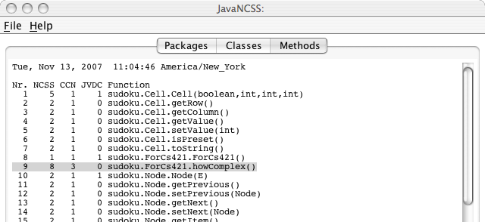
OUTPUT FROM JAVANCSS

Slide 14
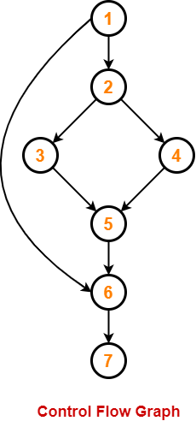
PRACTICE PROBLEMS BASED ON CYCLOMATIC COMPLEXITY-
Problem-01:
Calculate cyclomatic complexity for the given code-
IF A = 354
THEN IF B > C
THEN A = B
ELSE A = C
END IF
END IF
PRINT A
Solution-
We draw the following control flow graph for the given code-
Using the above control flow graph, the cyclomatic complexity may be calculated as-

Slide 15
Method-01:
Cyclomatic Complexity
= Total number of closed regions in the control flow graph + 1
= 2 + 1
= 3
Method-02:
Cyclomatic Complexity
= E – N + 2
= 8 – 7 + 2
= 3
Method-03:
Cyclomatic Complexity
= P + 1
= 2 + 1
= 3

Slide 16
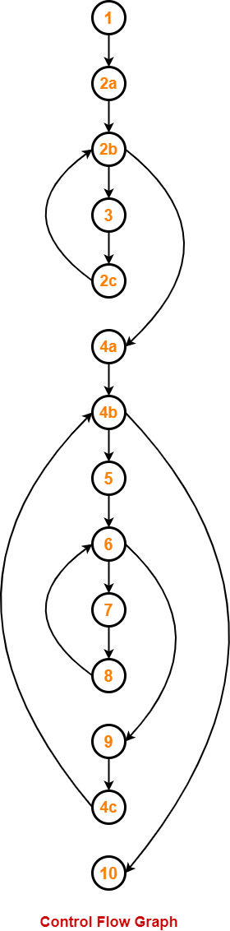
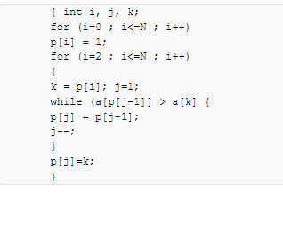
PROBLEM-02:
Calculate cyclomatic complexity for the given code-
We draw the following control flow graph for the given code-
Using the above control flow graph, the cyclomatic complexity may be calculated as-

Slide 17
Method 1
Cyclomatic Complexity
= Total number of closed regions in the control flow graph + 1
= 3 + 1
= 4
Method-02:
Cyclomatic Complexity
= E – N + 2
= 16 – 14 + 2
= 4
Method-03:
Cyclomatic Complexity
= P + 1
= 3 + 1
= 4

Slide 18
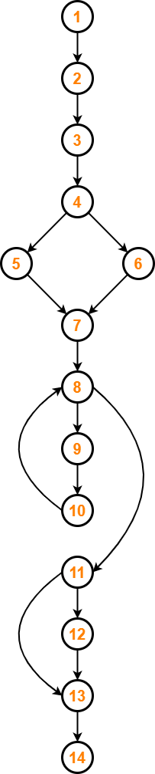
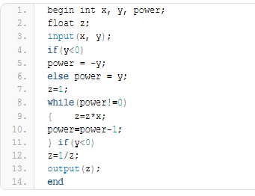
PROBLEM-03:
Calculate cyclomatic complexity for the given code-
Solution-
We draw the following control flow graph for the given code-
Using the above control flow graph, the cyclomatic complexity may be calculated as-

Slide 19
Method-01:
Cyclomatic Complexity
= Total number of closed regions in the control flow graph + 1
= 3 + 1
= 4
Method-02:
Cyclomatic Complexity
= E – N + 2
= 16 – 14 + 2
= 4
Method-03:
Cyclomatic Complexity
= P + 1
= 3 + 1
= 4

Slide 20
REFERENCE:
https://www.gatevidyalay.com/tag/cyclomatic-complexity-example-ppt/

